Slide 1


JustAsk: Your one-stop solution for instant answers to any question
Group 8

Slide 2
Subspace and Audience
Sub-space in Digital Learning:
Specialized virtual environments within broader e-learning platforms.
Tailored to specific learning needs or methods.
Examples: Virtual labs for science, discussion forums for literature.
Audience - Educators
At the forefront of the digital education transformation.
Active contributors, not just end-users.
Needs: Enhanced engagement, real-time feedback, simplified administrative tasks.
Bridge to understanding student behaviors and needs.

Slide 3
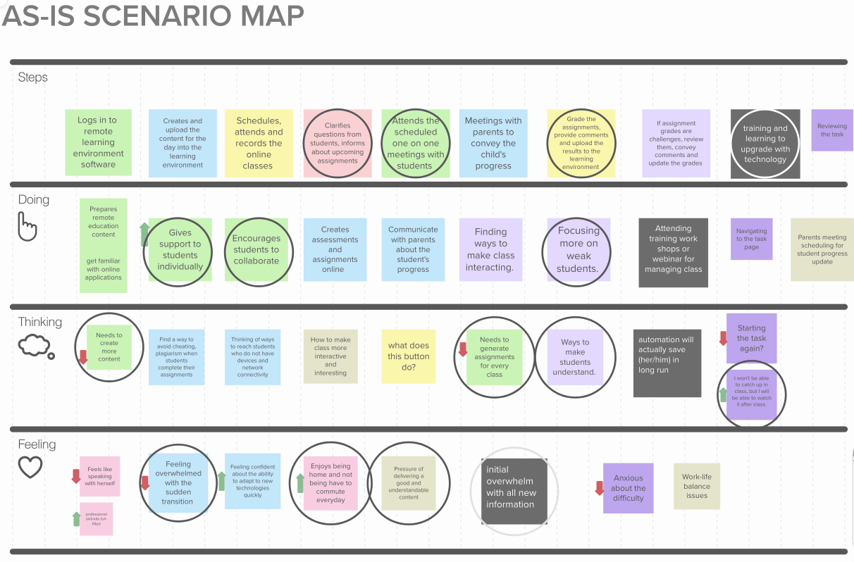
As-Is Scenario
According to the as-is scenario map, we have the following ideas for common educators:
clarifies student questions
educates according to scheduled assignments
participates in one-on-one meetings with students as arranged.
grades assignments, provides feedback, and uploads the findings to the learning environment, trains, and learns to improve with technology
What teachers are doing:
providing personalized support to learners
encouraging students to collaborate
focusing more on weak individuals.​
What teachers are thinking:
more content is needed, assignments for each class are needed
ways to make students understand are needed
I won't be able to catch up in class, but I will be able to view it after class.
What teachers are feeling:
feel overwhelmed by the quick shift, love staying at home and not having to commute every day
the pressure to offer good and intelligible content, as well as the first overwhelm with all new information

Slide 4
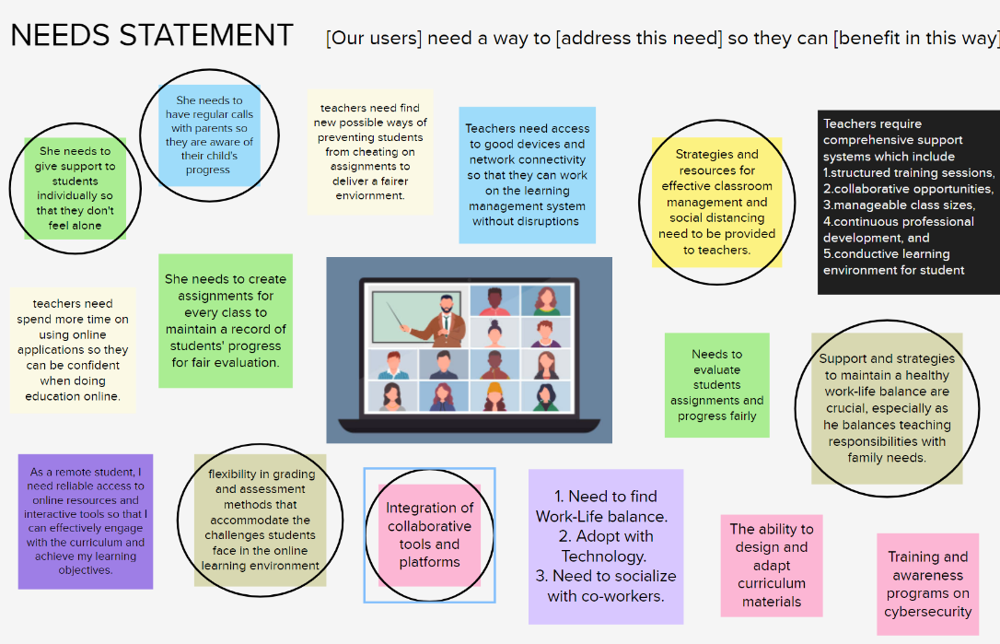
Needs statement
For Students:
A platform to submit question and seek clarification on the topic covered in the previous class.
A way to engage with the teacher for further explanations and insights on the subject matter.
The ability to explore additional resources and references for deeper understanding of course content.
Access to a wide variety of new learning materials related to the course.
For Teachers:
A system that allows to track individual student progress and identify areas where they may be struggling.
Access to data and feedback mechanisms to assess students' comprehension, skills, and potential areas of improvement.
Access to tools and resources for evaluating and
assessing students' performance.
4. Support and training in implementing AI- based assessment methods to enhance the educational experience.

Slide 5
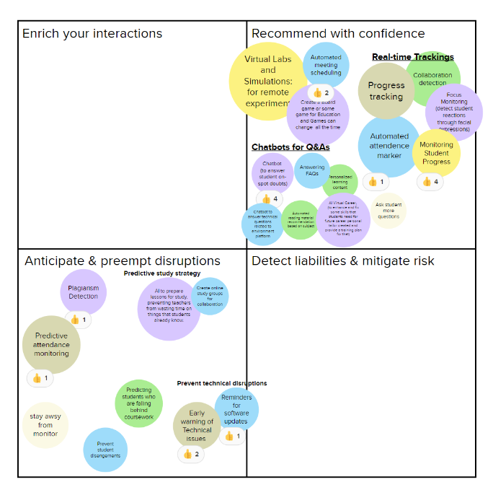
Intent and Idea
INTENT
Feedback and Assessment
Monitoring Student Progress
Answering FAQs
24/7 Support
Tutoring and Homework Help
IDEA
Conversational Interface
Data Analysis
User Assistance

Slide 6
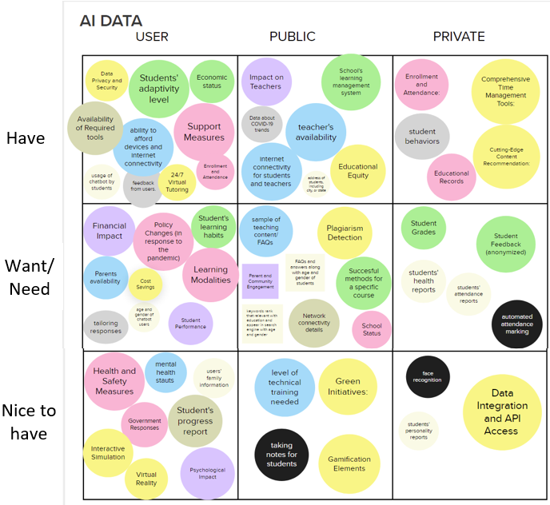
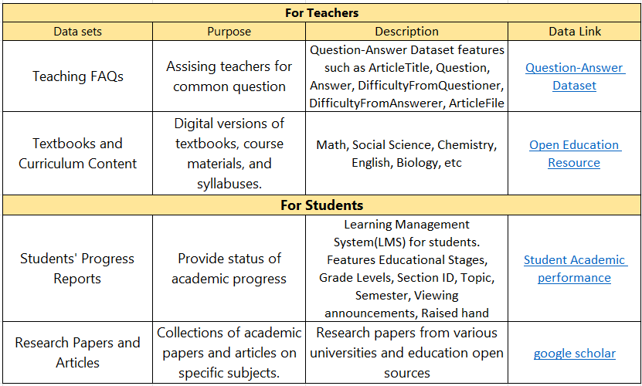
Data Sources
For Teachers,
Impact on teaching
24/7 Virtual tutoring
Query of chat bot
FAQs/ Feedback
For Students,​
Student progress report​
level of technical training​
student grade​
school learning management system (LMS)
Health reports

Slide 7
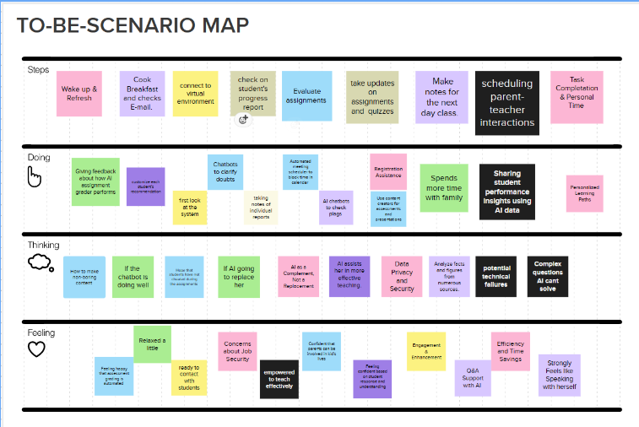
To be Scenario
Key Aspects of To Be Scenario:
Steps:
Wake up, refresh, cook breakfast and check emails
Connect to the virtual environment and start classes
Create quizzes and evaluate them
Schedule one on one sessions with students and parents
Doing:
Use chatbots to answer FAQs
Use application to add feedback about students
Use insights to identify students that are struggling and reach out to them
Spend more time with their family
Thinking:
Worried about AI replacing her
How AI is helping her reduce her workload
Feeling:
Relaxed due to extra time and happy to spend it with family
Feeling confident about adapting to new technology
Feeling relieved that certain processes are automated

Slide 8
Tasks
Scenario – Student
Ask a question (FAQs)
Access previous chat history
Scenario – Teacher
Find pain points for students and address it
Add a feedback for a student

Slide 9
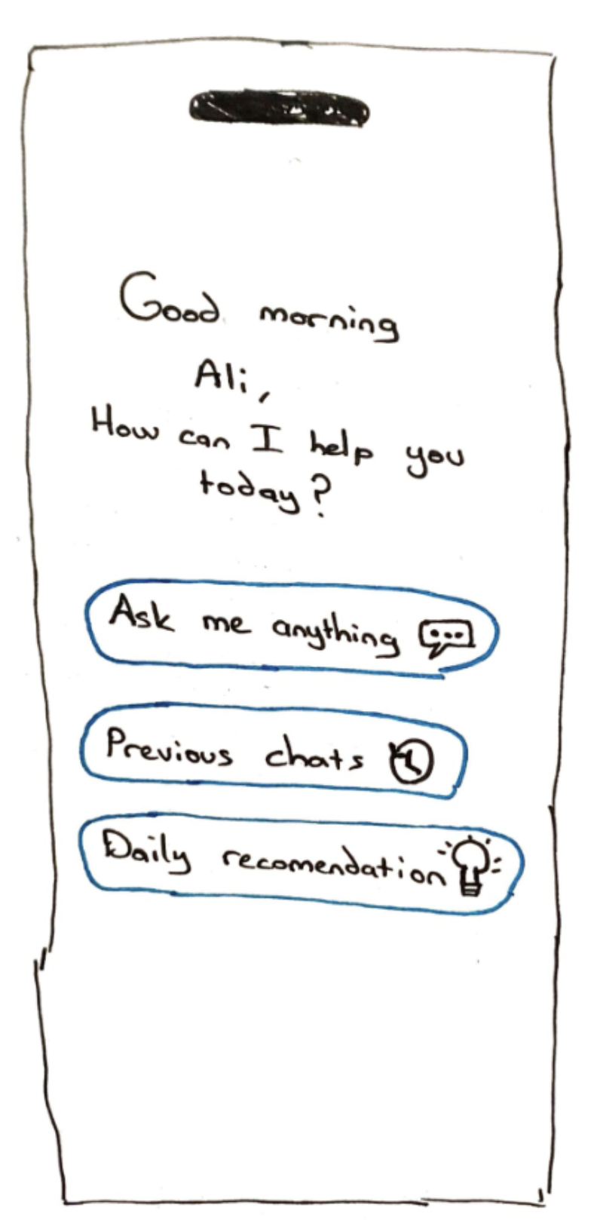
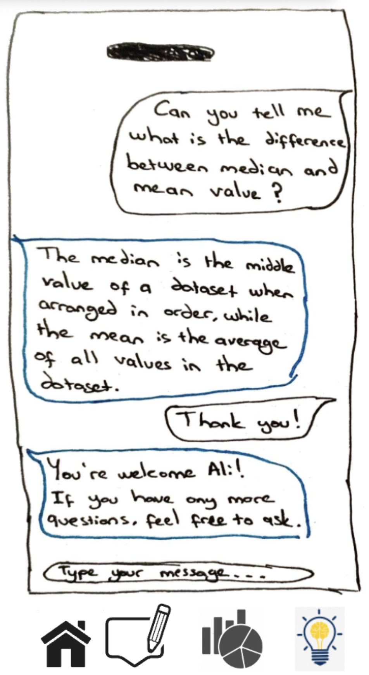
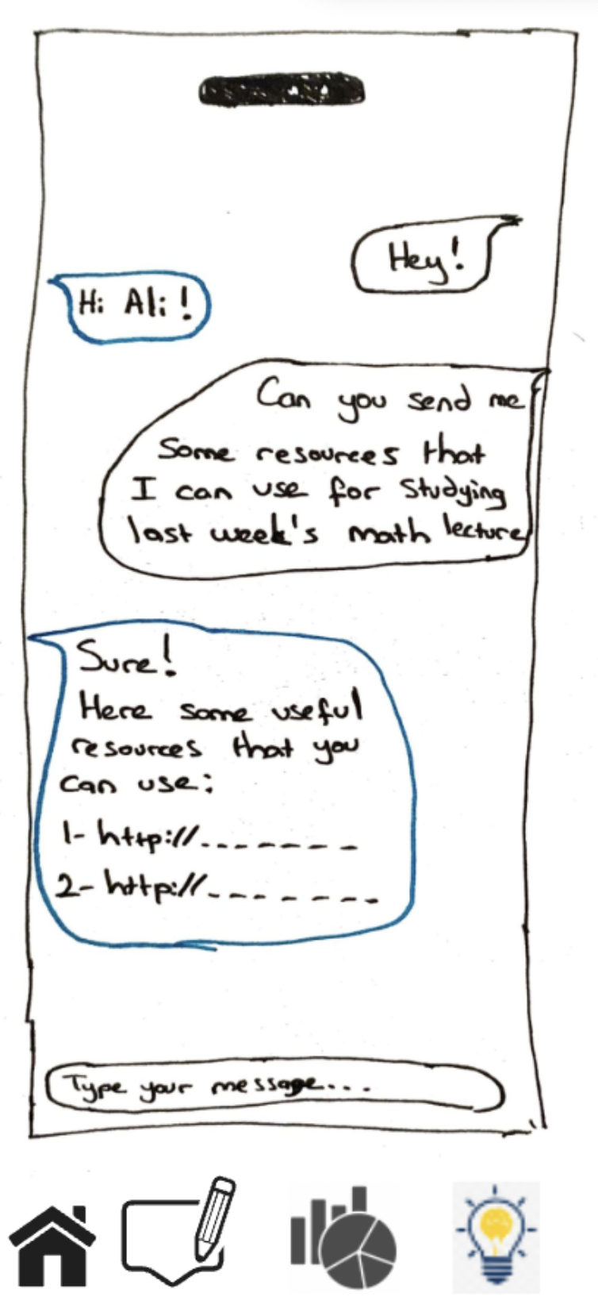
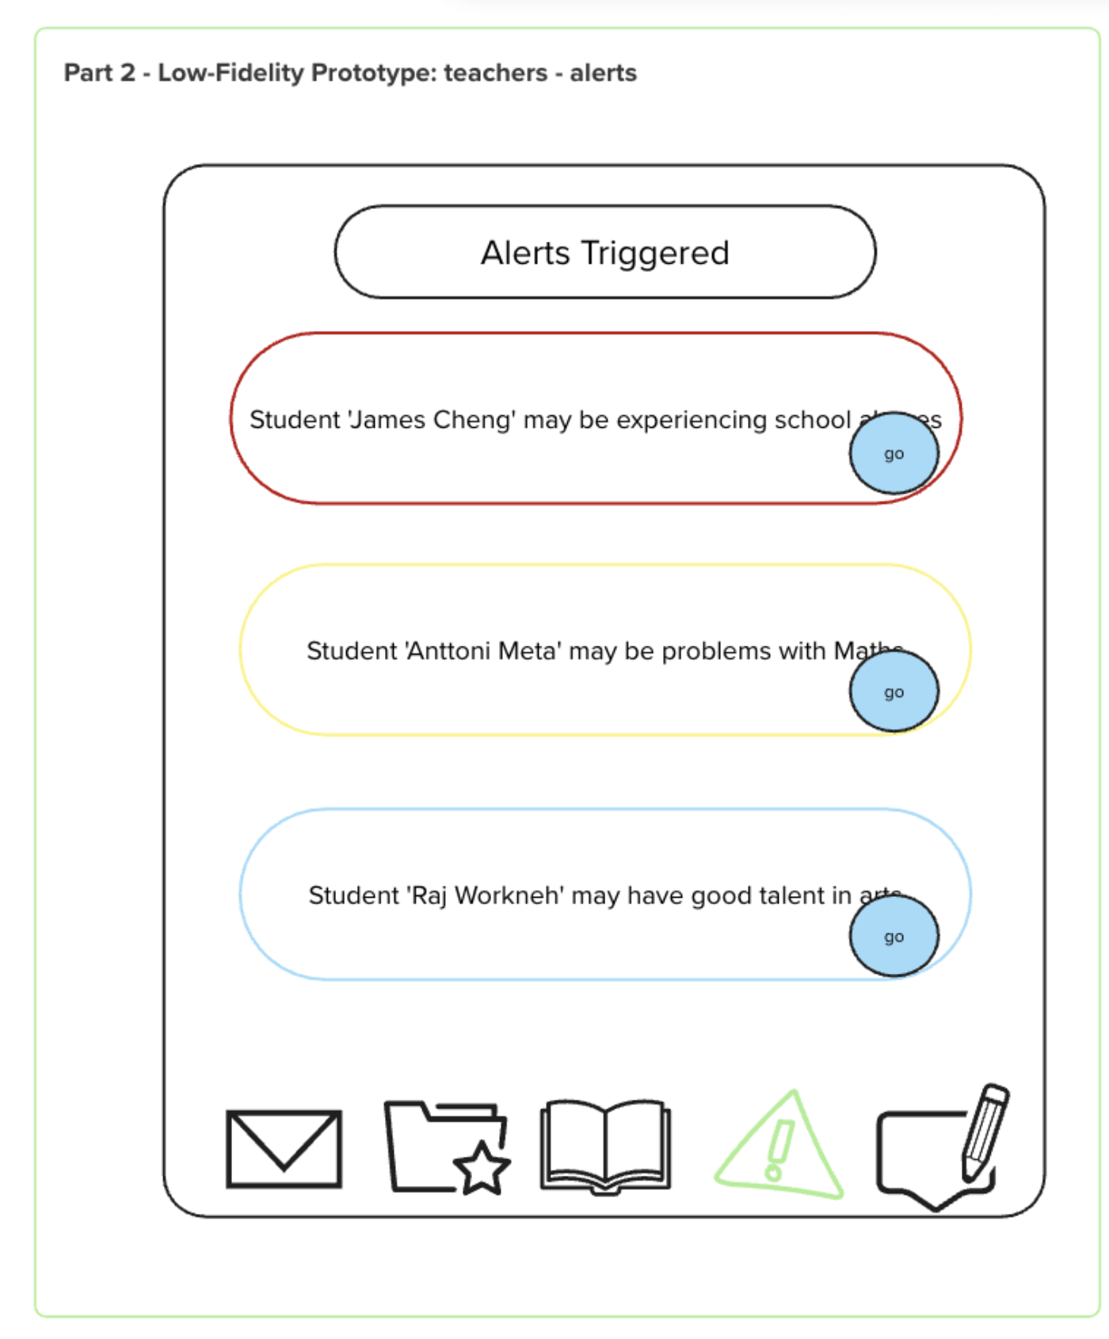
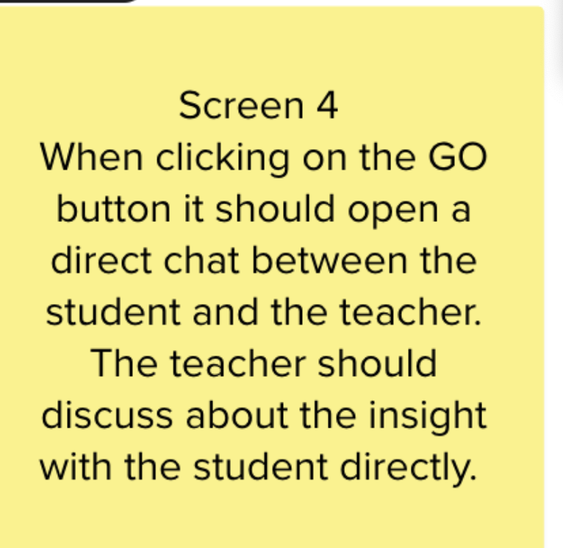
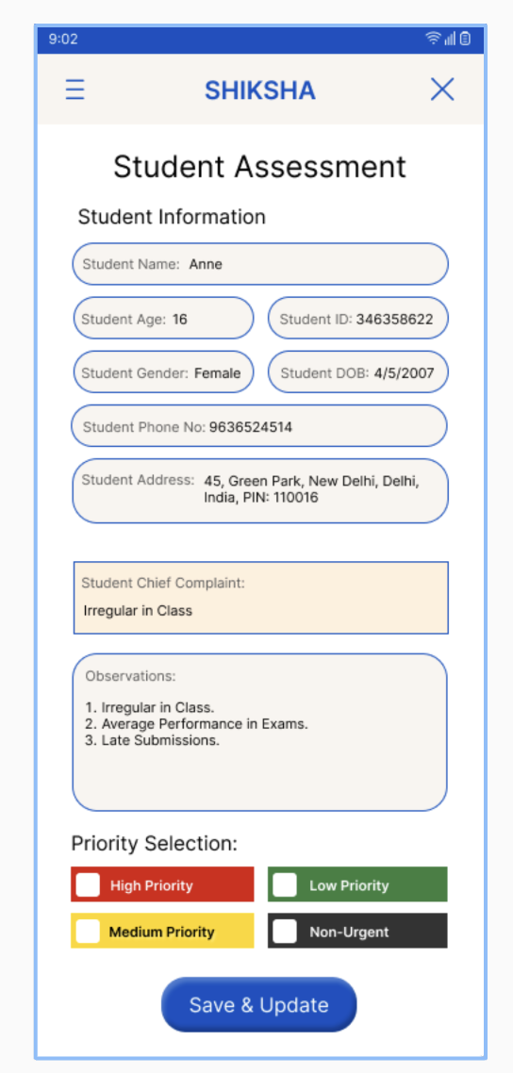
Initial prototype

Slide 10
Usability Script
Scenario 1: You are a 2nd year student in Social Sciences. Your teacher made an announcement about a new app that can be used to clarify any doubts that you may have.
You are learning about a new topic in a class, and you are confused about it. How will you use the app to seek help?
Last week you had asked the application questions related to a project. You forgot to makes notes from it. You want to access it now and take relevant notes. Can you please show us how you can do this?
Scenario 2: You are a math teacher. You heard about an application that can be used to monitor student's progress and provide them with instant help and feedback. You decide to try it out.
You want to check whether students are facing difficulties with any specific topic. If they are struggling, how will you reach out to them?
You notice that there are certain students that participate actively during the online classes, and you want to keep track of these students. How will you do this?

Slide 11
Feedback from testing
Rephrase task 1 for teacher – It was earlier worded as "You want to see which students have trouble at which points "
Rephrased it to "You want to check whether students are facing difficulties with any specific topic. If they are struggling, how will you reach out to them?"
Add a timeline for the alerts/insights that are generated
The time in which the insight was generated by the application is also visible now
Add relevant icons at the bottom of each screen so that it is easy to navigate to different screens
For ease of navigation we added the relevant icons at the bottom of each page

Slide 12
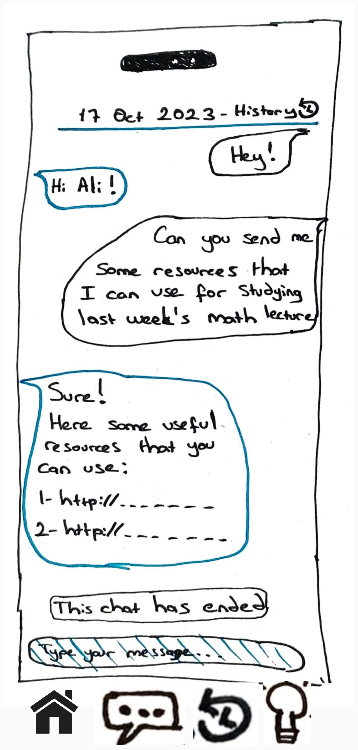
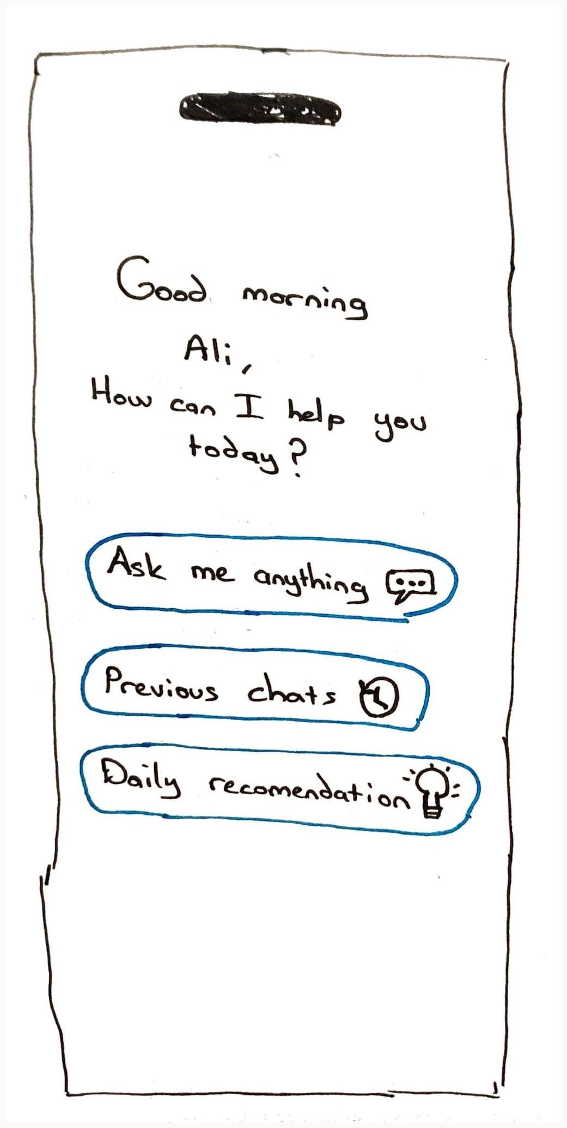
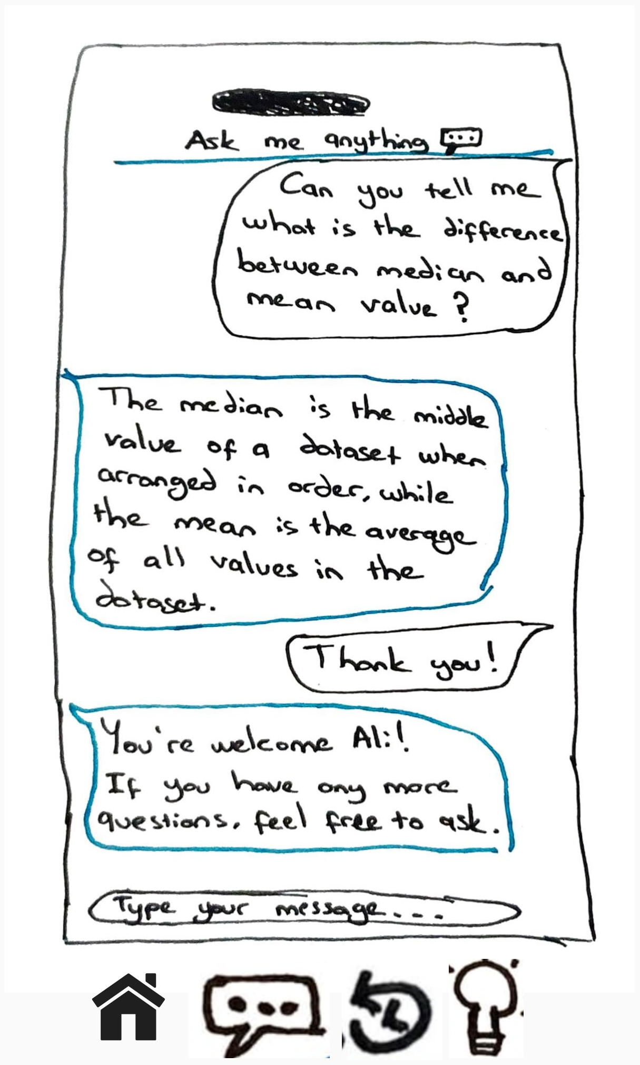
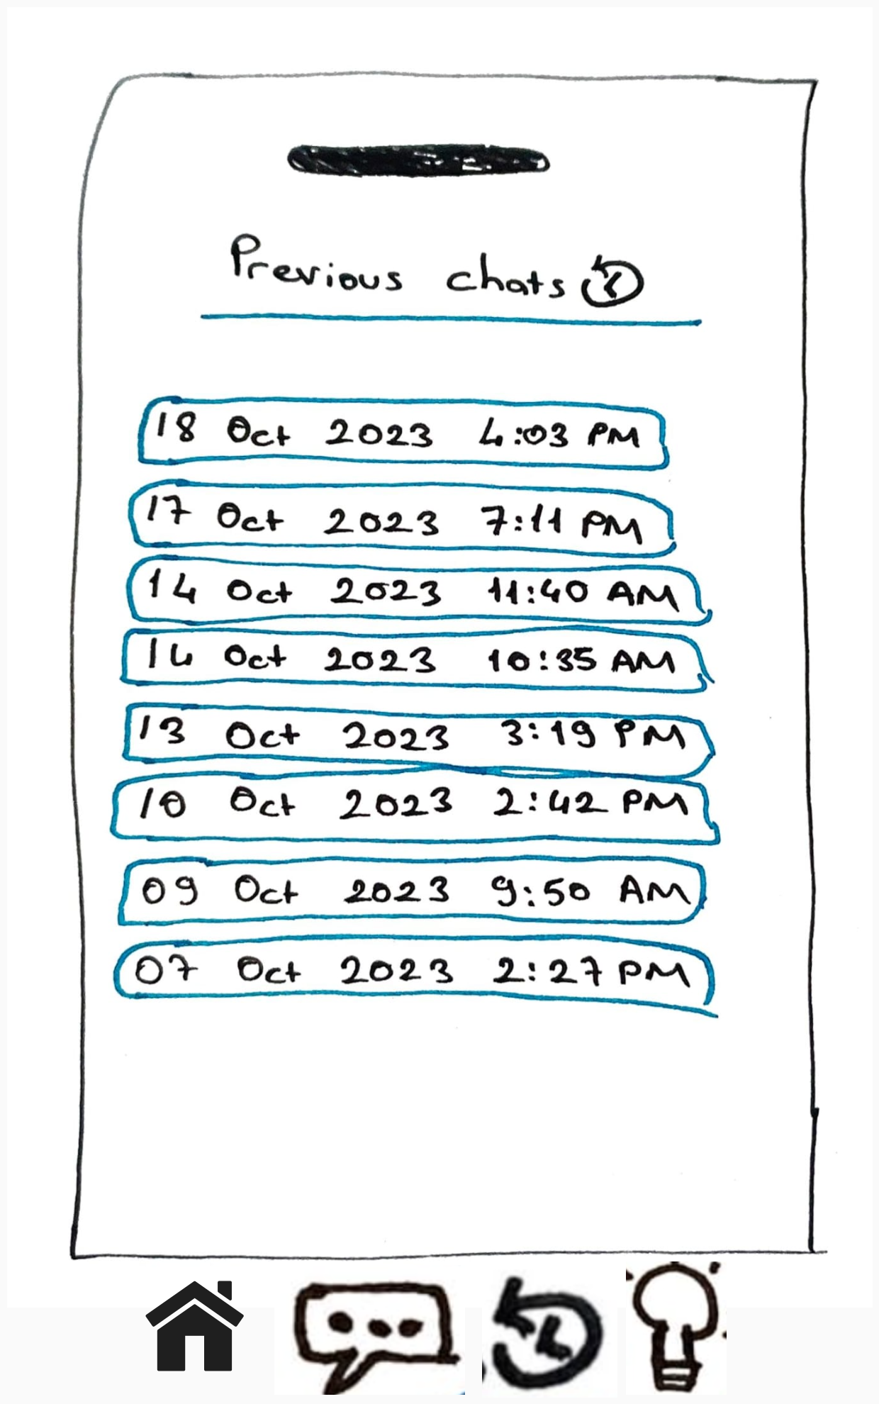
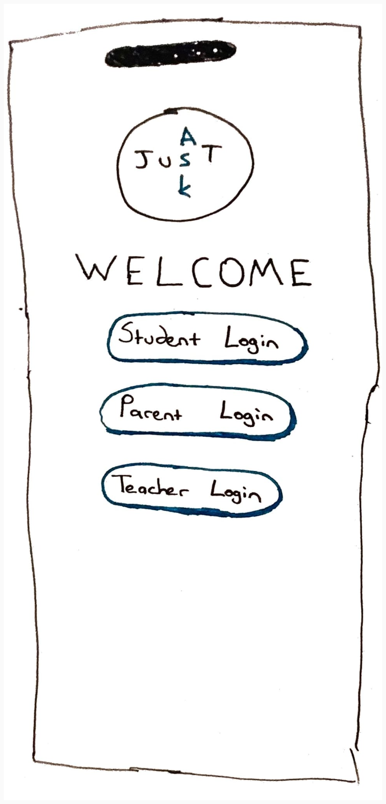

Final Prototype Scenario-Student

Slide 13
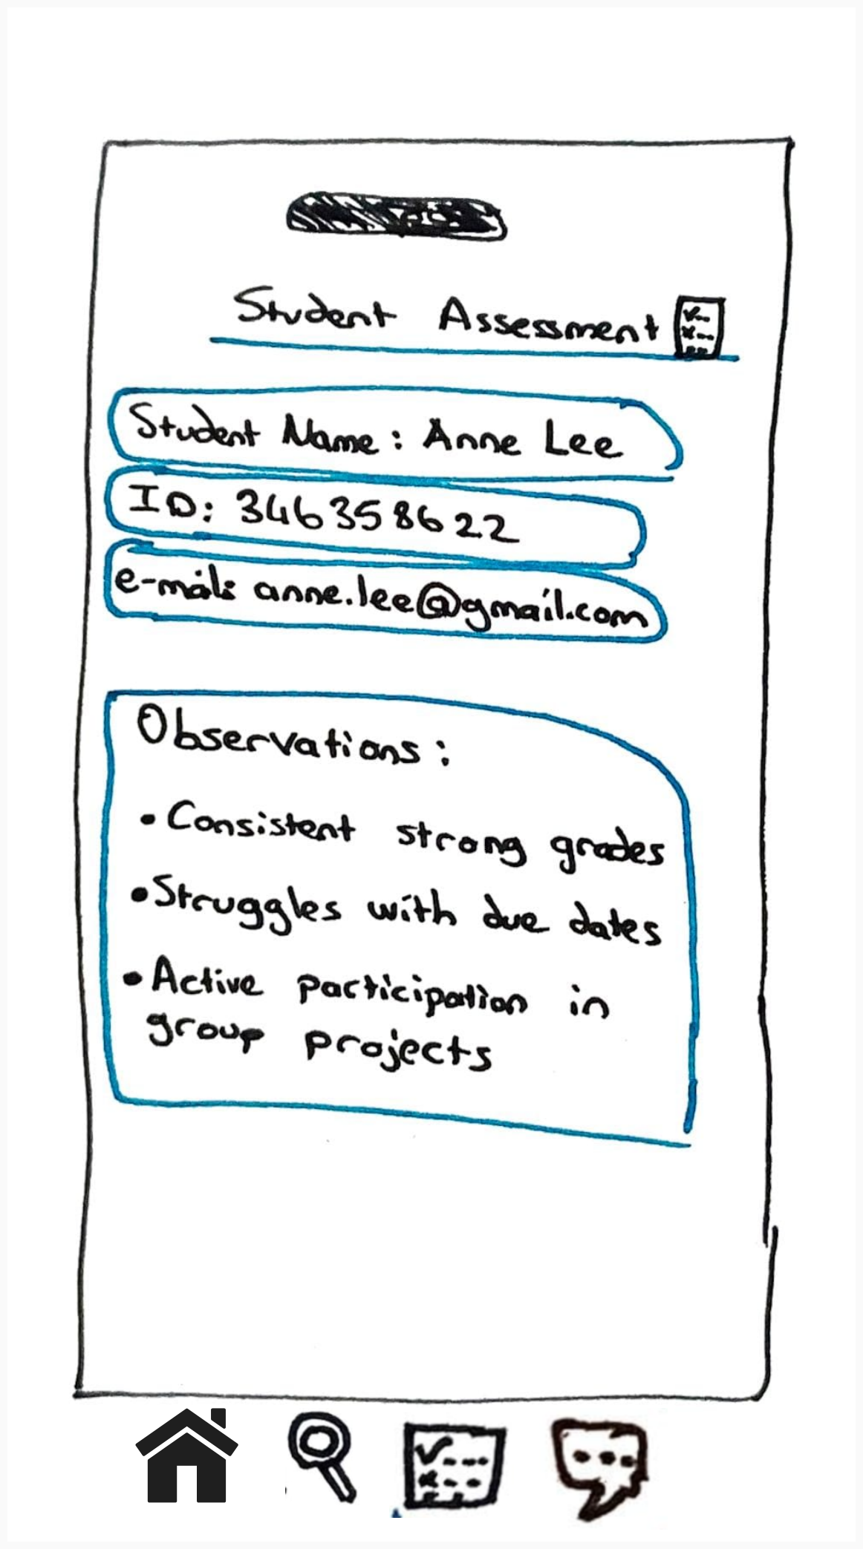
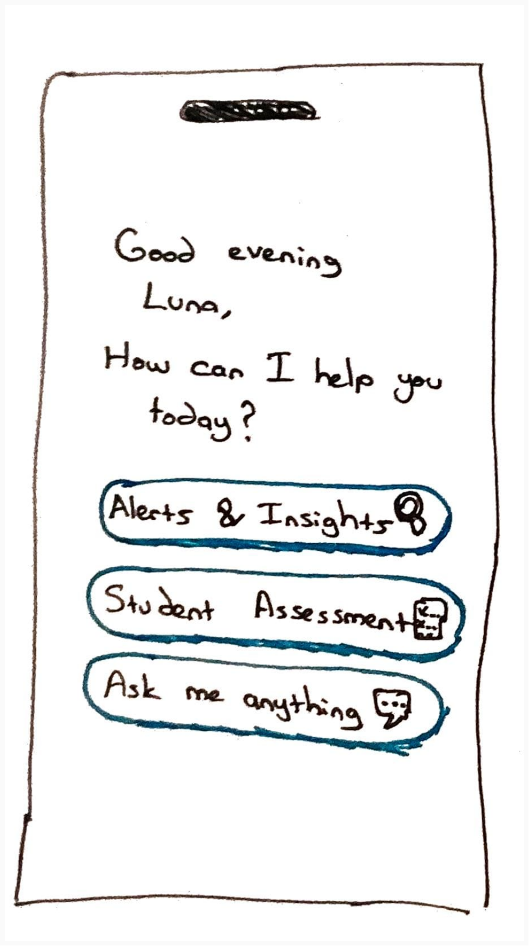
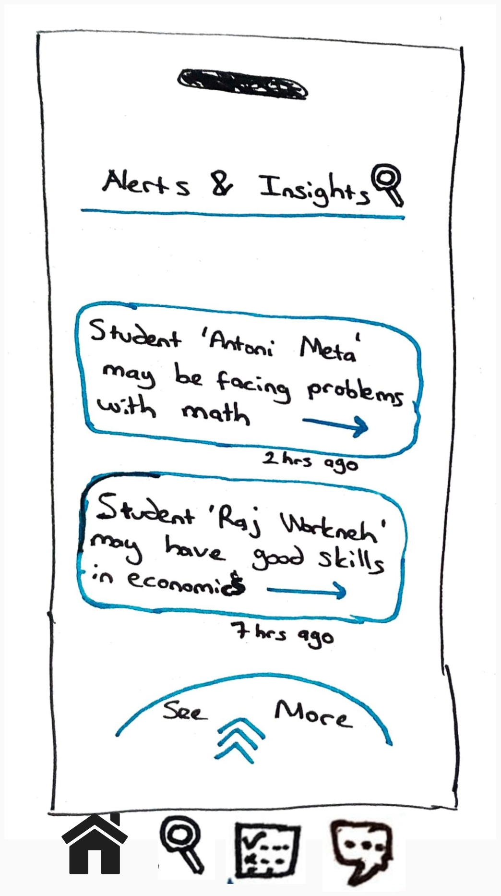
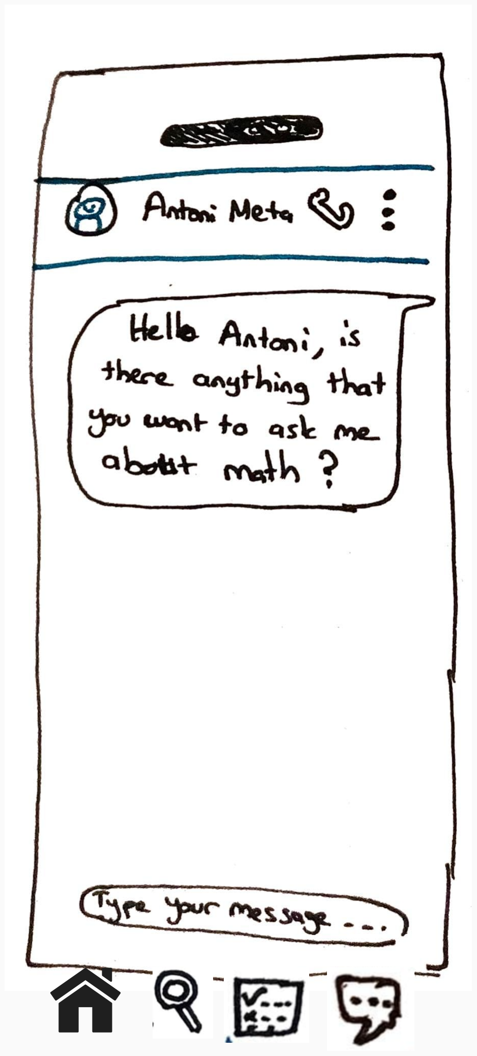
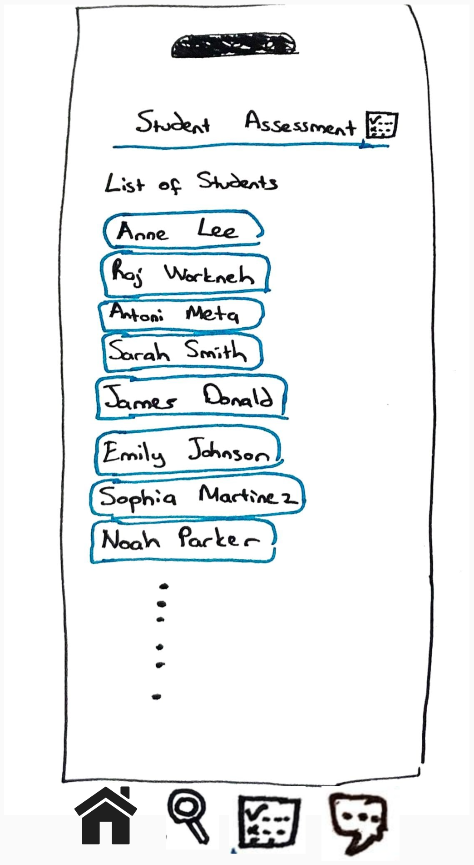
Final Prototype Scenario-Teacher

Slide 14
Thank You
Group Members 1. Kumud
2. Baris Alan
3. Qianfan Cheng
4. Ali Guneysel
5. Sut Ring Ja K P
6. Erinda Kapllani
7. Rajvi Patel
8. Kajhonprom Trongkitroongruang
9. Madhoumithaa Veerasethu

